Slide 1

Distributed Security Risks and Opportunities in the W3C Web of Things
Michael McCool (presenting) and Elena Reshetova
NDSS DISS 2018 February 18, 2018 San Diego https://github.com/mmccool/ndss-wot-sec

Slide 2
Outline
Goals
W3C Web of Things
Risks and Opportunities
Local Links
Vulnerability Analysis
Endpoint Adaptation
Secure Discovery
Security Metadata
Summary and Conclusions

Slide 3
Goals
Why this paper?
Necessary to perform security review of standards under development
Paper lists a number of problems with the proposed W3C Web of Things standard under development that need to be addressed
Some issues are generalizable to other Web/IoT systems with metadata: DDS, OCF, IPSO, OneM2M, OpenAPI, etc.
The paper does not, generally, propose solutions
Desired outcome:
Discussion, collaboration, and research to find solutions to these problems.

Slide 4

Web of Things
Working Group within W3C chartered December 2016
Based on ongoing work in an Interest Group by the same name
Target date of December 2018 to deliver specifications for
Thing Description: metadata for describing Things
Scripting API: standardized mechanism to consume and expose Thing Descriptions and program the behavior of Things
Protocol Bindings: mappings of WoT architecture to various concrete protocols: HTTP, CoAP, MQTT, etc.
Mapping from abstract Property/Event/Actions CRUDN and/or Pub/Sub

Slide 5
Web of Things: Resources and Links
W3C: World Wide Web Consortium: https://www.w3.org
Web of Things Interest Group: https://www.w3.org/WoT/IG/
Charter: Leverage web standards and technology to enable IoT interoperation
Web architecture: https://www.w3.org/standards/webarch/
Web of Things Working Group to develop standard recommendations:
Charter: https://www.w3.org/2016/09/wot-wg-charter.html
Co-chairs: Matthias Kovatsch (Siemens), Kazuo Kajimoto (Panasonic), Michael McCool (Intel)
White paper on WoT architecture: http://w3c.github.io/wot/charters/wot-white-paper-2016.html
WoT current practices: http://w3c.github.io/wot/current-practices/wot-practices.html
Notes:
Need to update links to latest content. Maybe move to backup.

Slide 6
WoT: Deliverables/Architecture
WoT Servient
JavaScript
1. WoT Thing Description (TD) with simple interaction model
Runtime Environment
Lua
Properties
App Script 2
3. WoT Scripting API for a browser-like runtime environment
Actions
Events
App Script 1
Scripting API
Thing Description
Interaction Model
Local Hardware
Binding Templates
2. WoT Binding Templates to connect to different platforms and ecosystems
Things can be in client and/or server role: “Servient”
Server
Client
HTTP
OCF
BACnet
Expose
Consume
CoAP
OneM2M
…

Slide 7
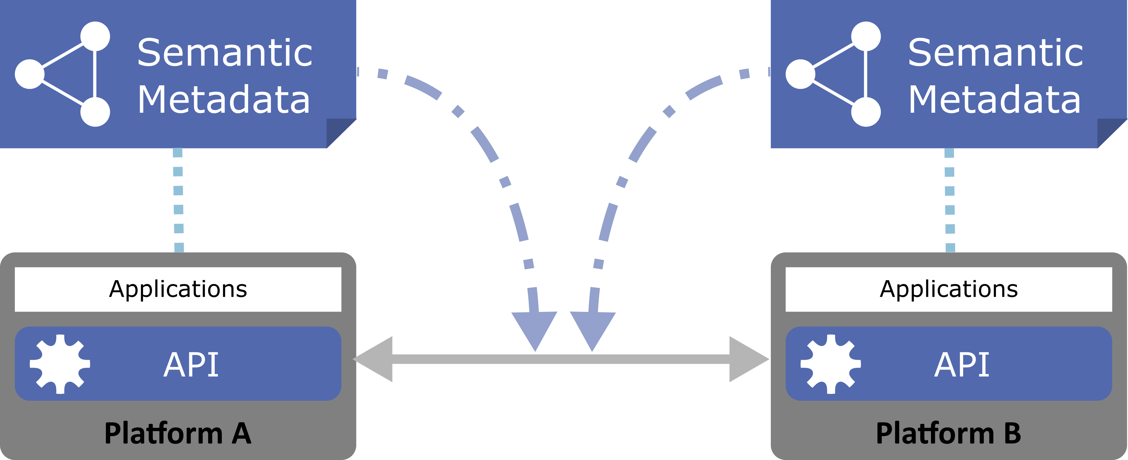
WoT Key Deliverable: Thing Description
Standardized Semantic Metadata
Protocol-independent description of network APIs
Communication and security requirements
Data models and constraints
Semantic annotation
Notes:
To do: Semantic Metadata -> Thing Description

Slide 8
Thing Description Example
W3C WoT TD vocabulary
{
"@context": [
"http://w3c.github.io/wot/w3c-wot-td-context.jsonld",
{ "domain": "http://example.org/actuator#" }
],
"@type": "Thing",
"name": "MyLEDThing",
"base": "coap://myled.example.com:5683/",
"security": {
"cat": "token:jwt",
"alg": "HS256",
"as": "https://authority-issuing.example.org"
},
"interaction": [
{
"@type": ["Property", "domain:onOffStatus"],
"name": "status",
"outputData": {"valueType": {"type": "boolean"}},
"writable": true,
"links": [
{
"href": "pwr",
"mediaType": "application/exi"
},
{
"href": "http://mytemp.example.com:8080/status",
"mediaType": "application/json"
}
]
},
{
"@type": ["Action", "domain:fadeIn"],
"name": "fadeIn",
"inputData": {
"valueType": {"type": "integer"},
"domain:unit": "domain:ms"
},
"links": [
{
"href": "in",
"mediaType": "application/exi"
},
{
"href": "http://mytemp.example.com:8080/in",
"mediaType": "application/json"
}
]
},
{
"@type": ["Action", "domain:fadeOut"],
"name": "fadeOut",
"inputData": {
"valueType": {"type": "integer"},
"domain:unit": "domain:ms"
},
"links": [
{
"href": "out",
"mediaType": "application/exi"
},
{
"href": "http://mytemp.example.com:8080/out",
"mediaType": "application/json"
}
]
},
{
"@type": ["Event", "domain:alert"],
"name": "criticalCondition",
"outputData": {"valueType": {"type": "string"}},
"links": [
{
"href": "ev",
"mediaType": "application/exi"
}
]
}
]
}
JSON-LD (Linked Data)
Domain-specific vocabulary
Security metadata
JSON Schema
Notes:
Update example to consensus… protocol binding document? TD?
Have bubble calling out security metadata

Slide 9
{
"@context": [
"http://w3c.github.io/wot/w3c-wot-td-context.jsonld",
{ "domain": "http://example.org/actuator#" }
],
"@type": "Thing",
"name": "MyLEDThing",
"base": "coap://myled.example.com:5683/",
"security": {
"cat": "token:jwt",
"alg": "HS256",
"as": "https://authority-issuing.example.org"
},
"interaction": [
{
"@type": ["Property", "domain:onOffStatus"],
"name": "status",
"outputData": {"valueType": {"type": "boolean"}},
"writable": true,
"links": [
{
"href": "pwr",
"mediaType": "application/exi"
},
{
"href": "http://mytemp.example.com:8080/status",
"mediaType": "application/json"
}
]
},
{
"@type": ["Action", "domain:fadeIn"],
"name": "fadeIn",
"inputData": {
"valueType": {"type": "integer"},
"domain:unit": "domain:ms"
},
"links": [
{
"href": "in",
"mediaType": "application/exi"
},
{
"href": "http://mytemp.example.com:8080/in",
"mediaType": "application/json"
}
]
},
{
"@type": ["Action", "domain:fadeOut"],
"name": "fadeOut",
"inputData": {
"valueType": {"type": "integer"},
"domain:unit": "domain:ms"
},
"links": [
{
"href": "out",
"mediaType": "application/exi"
},
{
"href": "http://mytemp.example.com:8080/out",
"mediaType": "application/json"
}
]
},
{
"@type": ["Event", "domain:alert"],
"name": "criticalCondition",
"outputData": {"valueType": {"type": "string"}},
"links": [
{
"href": "ev",
"mediaType": "application/exi"
}
]
}
]
}
Property
Action

Slide 10
{
"@context": [
"http://w3c.github.io/wot/w3c-wot-td-context.jsonld",
{ "domain": "http://example.org/actuator#" }
],
"@type": "Thing",
"name": "MyLEDThing",
"base": "coap://myled.example.com:5683/",
"security": {
"cat": "token:jwt",
"alg": "HS256",
"as": "https://authority-issuing.example.org"
},
"interaction": [
{
"@type": ["Property", "domain:onOffStatus"],
"name": "status",
"outputData": {"valueType": {"type": "boolean"}},
"writable": true,
"links": [
{
"href": "pwr",
"mediaType": "application/exi"
},
{
"href": "http://mytemp.example.com:8080/status",
"mediaType": "application/json"
}
]
},
{
"@type": ["Action", "domain:fadeIn"],
"name": "fadeIn",
"inputData": {
"valueType": {"type": "integer"},
"domain:unit": "domain:ms"
},
"links": [
{
"href": "in",
"mediaType": "application/exi"
},
{
"href": "http://mytemp.example.com:8080/in",
"mediaType": "application/json"
}
]
},
{
"@type": ["Action", "domain:fadeOut"],
"name": "fadeOut",
"inputData": {
"valueType": {"type": "integer"},
"domain:unit": "domain:ms"
},
"links": [
{
"href": "out",
"mediaType": "application/exi"
},
{
"href": "http://mytemp.example.com:8080/out",
"mediaType": "application/json"
}
]
},
{
"@type": ["Event", "domain:alert"],
"name": "criticalCondition",
"outputData": {"valueType": {"type": "string"}},
"links": [
{
"href": "ev",
"mediaType": "application/exi"
}
]
}
]
}
Event (sources, sinks, …)

Slide 11
Problem 1: Local Links
Risks
WoT is predicated on Web standards being useful for IoT
For example, being able to use web browsers as IoT device user interfaces
However…
Web is oriented towards browsers and human-readable information
IoT is oriented towards machine-to-machine communications
Web browsers assume an active full internet connection
IoT devices may only have local network connectivity
One major pain point:
Browser assumptions about certificate revocation checking under HTTPS
Primarily affects use of HTTPS for “local” user interfaces

Slide 12
Problem 2: Vulnerability Analysis
Risks
Pervasive metadata allows attacker to analyze a system in detail to find vulnerabilities and plan an attack
Opportunity
Pervasive metadata allows a system owner to analyze a system in detail to find vulnerabilities and prevent attacks
➔ Metadata needs to be made available only to trusted users.
Note: Semantic annotation makes this more powerful, as we can also automate interferencing, and also get more information about the physical installation and use of the device.

Slide 13
Problem 3: Endpoint Adaptation
Risks
Protocol conversion bridges are vulnerable to attack, as protocol conversion may require “unpacking” data in flight, making it available to interception
Opportunity
A system wishing to talk to a WoT Thing can access the metadata for a thing and set up an end-to-end encrypted channel directly to that thing, bypassing intermediate payload translation steps
A
T
B
A
B
Notes:
TODO: needs a diagram

Slide 14
Problem 4: Semantic Discovery
Risks
Semantic search is relatively expensive
Pathological semantic queries can be created that can consume an unreasonable amount of resources
If semantic discovery services are “open”, then they will be subject to denial of service attacks
Opportunity
Semantic discovery is a powerful capability we would like to make available to users
➔ How to manage trust?
Notes:
TODO: where do we discuss protection of the metadata: authorized access, authentication, etc?

Slide 15
Problem 5: Security Metadata
Opportunity
A Thing Description can provide information that can be useful for enabling distributed and/or decentralized security mechanisms
How can we make validated and authenticated TDs available in a decentralized fashion?
What security mechanisms should we support and what information do they need?
Examples:
Payments/deposits for services: Interledger address
Web of Trust: References
Access Control: Management Thing API
Discovery: Distributed discovery services and Thing Directories
Caching and proxies: Encrypted state and expected lifetime of cached data
Firewalls: Network policy, including expected incoming and outgoing traffic

Slide 16
Summary
Main W3C WoT deliverable and differentiator:
Universal metadata format (“Thing Description”) for IoT services (“Things”) and associated common Thing abstraction
Use of Web Standards for IoT has some specific issues:
Local links, HTTPS, and certificates
Use of semantic metadata has specific risks and opportunities:
Vulnerability analysis
Endpoint adaptation vs. link-by-link translation
Preventing denial-of-service attacks on semantic discovery services
Securing metadata and providing it only to trusted entities
NDSS DISS 2018

Slide 17
Follow-up Actions
WoT Plugfest – Prague, March 24-25, 2018
WoT Interest Group
WoT Working Group
W3C Web of Things Security and Privacy Considerations
Collaborations
WoT Security Validation

Slide 18






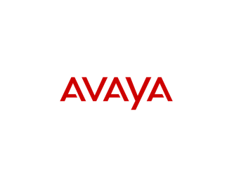





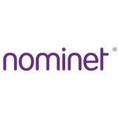




Web of Things: Interest Group Members

Slide 19
To add to the paper…
Expanded list of security metadata given in “Problem 5” slide on this presentation
Reference to Michal Krol’s paper at NDSS DISS using cryptocurrency deposits to support offload markets; this is one possible solution to how to provide open access to discovery services.
Discussion of “endpoint adaptation” issues wrt filtering proxies (eg what if proxies require access to headers etc. to do packet filtering?)

